Slide 1
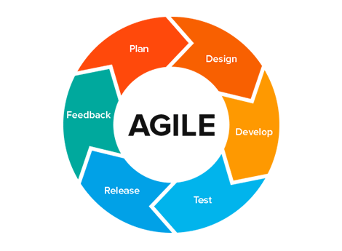
What is Agile Methodology
Agile Methodology emphasizes on four core values:
Individual and team interactions over processes and tools.
Working software over comprehensive documentation.
Customer collaboration over contract negotiation.
Responding to change over following a plan.
Agile Methodology

Slide 2
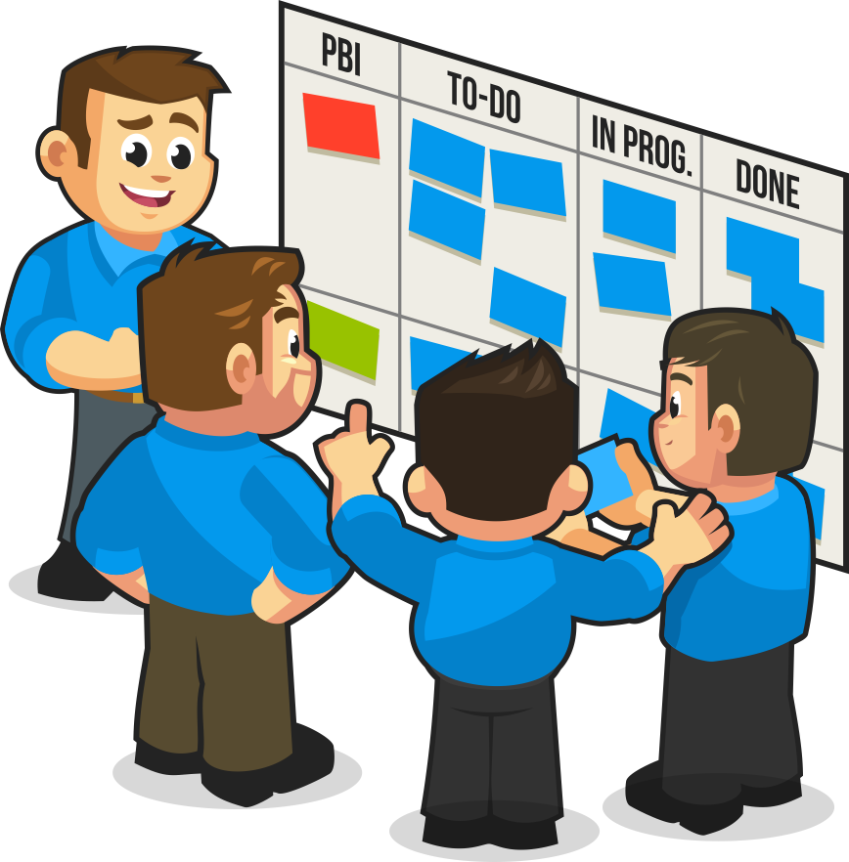
SCRUM
Scrum is an agile development method which concentrates specifically on how to manage tasks within a team-based development environment.
It is designed for teams of three to nine members, who break their work into actions that can be completed within time boxed iterations, called sprints.
Scrum scheduling

Slide 3
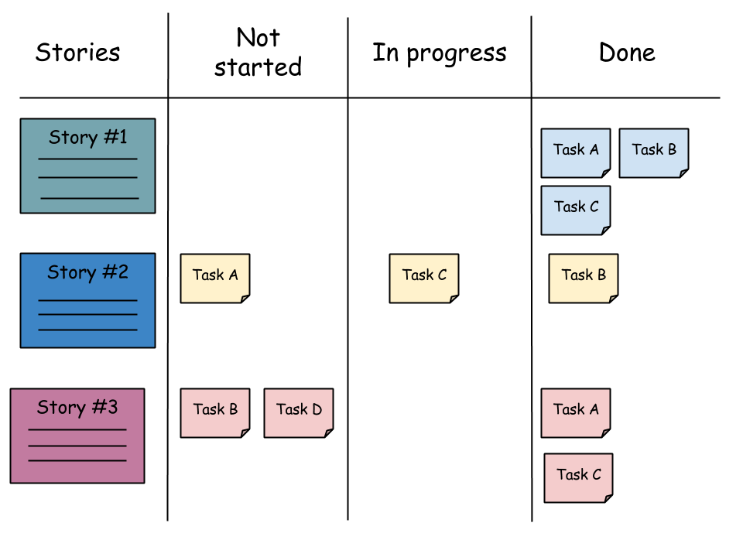
Scrum board
A Scrum Board is a tool that helps Teams make Sprint Backlog items visible. The board can take many physical and virtual forms but it performs the same function regardless of how it looks. The board is updated by the Team and shows all items that need to be completed for the current Sprint.
Scrum Board

Slide 4
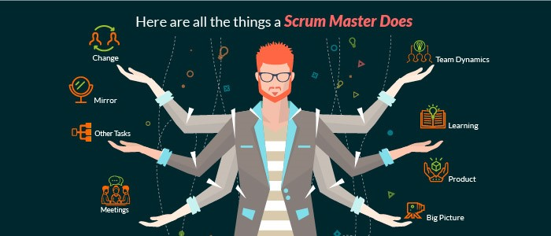
SCRUM MASTER
Scrum Master is responsible for setting up the team, sprint meeting and removes obstacles to progress.
The scrum master is not a traditional team lead or project manager but acts as a buffer between the team and any distracting influences.
The core responsibilities of a scrum master include
Coaching the team in order to deliver high-quality features for its product.
Facilitating team events to ensure regular progress.
Promoting self-organization and cross-functionality within the team.
Role of Scrum Master

Slide 5
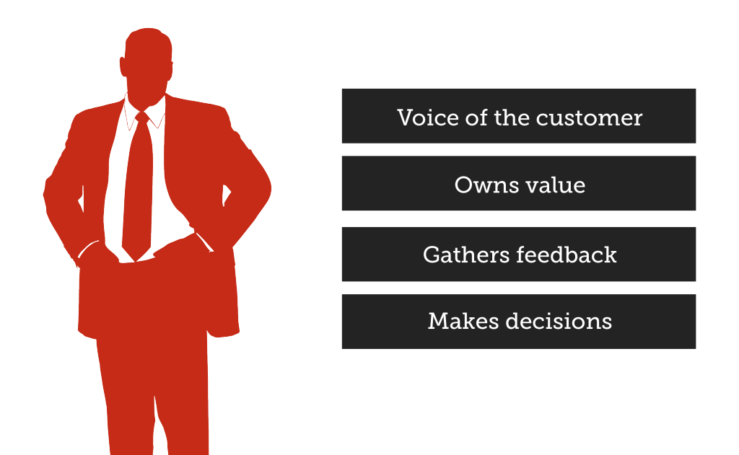
PRODUCT OWNER
The Product Owner creates product backlog, prioritizes the backlog and is responsible for the delivery of the functionality at each iteration.
A scrum team should have only one product owner
Some tasks of product owner include
organize further meetings to demonstrate the solution to key stakeholders
communicates delivery and team status
negotiates priorities, scope, funding, and schedule
Role of Product Owner

Slide 6
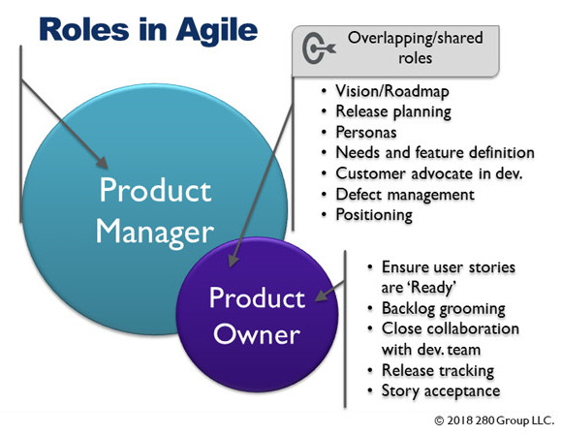
Role of product owner
The Scrum product owner is typically a project's key stakeholder.
Part of the product owner responsibilities is to have a vision of what he or she wishes to build, and convey that vision to the scrum team.
The Scrum product owner's job is to motivate the team with a clear, elevating goal.
The product owner is commonly a lead user of the system.
The product owner role requires an individual with certain skills and traits, including availability, business savvy and communication skills.

Slide 7
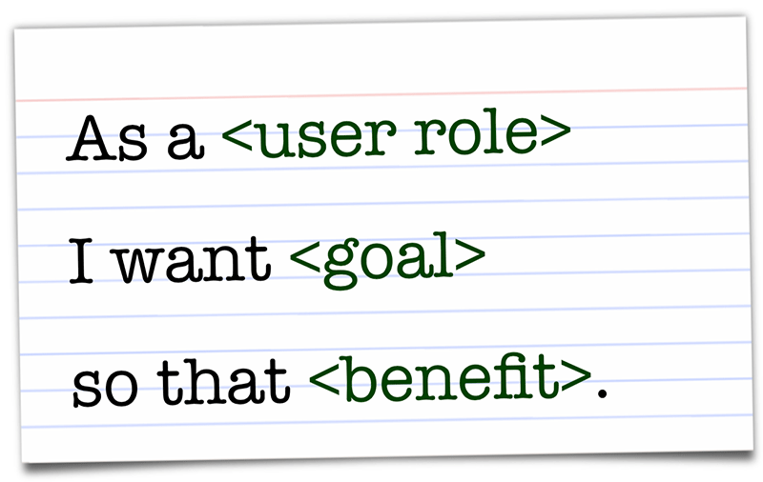

USER STORIES
User stories are one of the primary development artifacts for Scrum.
User story is simply something a user wants.
User stories represent customer requirements in a card leading to conversation and confirmation.
Template of User Story
As a <type of user>, I can <some goal> so that <some reason>
User Stories

Slide 8
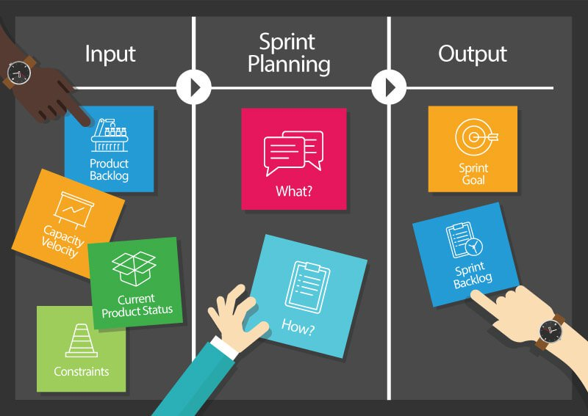
Sprint Planning
A Sprint team holds a Sprint planning to:
Mutually discuss and agree on the scope of work that is intended to be done during that sprint.
Select product backlog items that can be completed in one sprint.
The recommended duration is four hours for a two-week sprint.
Once the development team has prepared their sprint backlog, they forecast (usually by voting) which tasks will be delivered within the sprint.
Sprint Planning

Slide 9
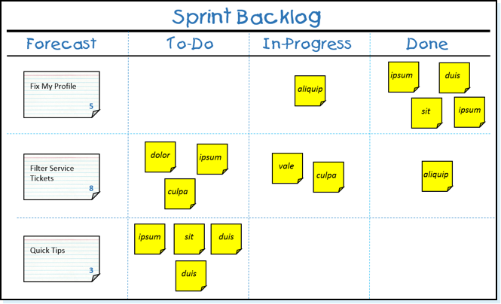
Sprint backlog
The sprint backlog is a list of tasks identified by the Scrum team to be completed during the Scrum sprint.
It's critical that the team selects the items and size of the sprint backlog.
The sprint backlog is commonly maintained as a spreadsheet, but it is also possible to use your defect tracking system or any of a number of software products designed specifically for Scrum or agile.
Spring backlog

Slide 10

Retrospection in Agile
A meeting that's held at the end of an iteration in Agile software development (ASD ). During the retrospective, the team reflects on what happened in the iteration and identifies actions for improvement going forward.
Each member of the team members answers the following questions:
1. What worked well for us?
2. What did not work well for us?
3. What actions can we take to improve our process going forward?

Slide 11
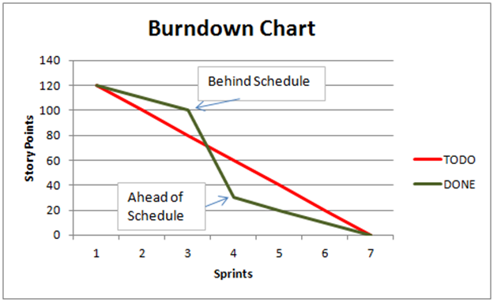
Burn down chart
A graphical representation of work left to do versus time.
Measuring performance
If the actual work line is above the ideal work line, it means that there is more work left than originally predicted and the project is behind schedule.
If the actual work line is below the ideal work line, it means that there is less work left than originally predicted and the project is ahead of schedule.

Slide 12
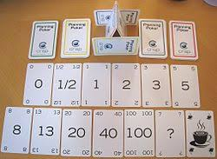
Poker planning
Planning Poker is a consensus-based estimating technique. Agile teams around the world use Planning Poker to estimate their product backlogs. Planning Poker can be used with story points, ideal days, or any other estimating unit.
Poker Planning

Slide 13
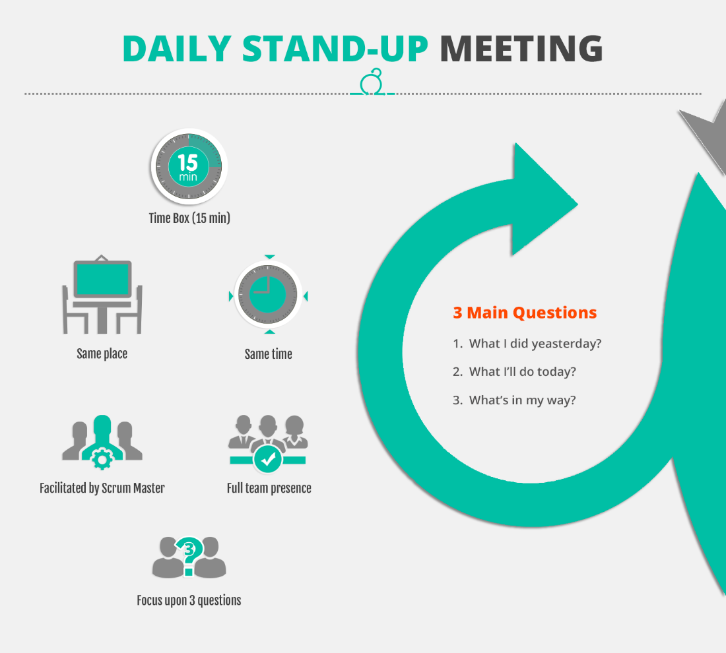
Daily standup
The daily stand-up meeting (also known as a "daily scrum", a "daily huddle", "morning roll-call", etc.) is simple to describe:
“The whole team meets every day for a quick status update. We stand up to keep the meeting short.”

Slide 14
Kanban
Kanban is a scheduling system for lean manufacturing and just-in-time manufacturing (JIT).
Taiichi Ohno, an industrial engineer at Toyota, developed kanban to improve manufacturing efficiency.
A goal of the kanban system is to limit the buildup of excess inventory at any point in production.

Slide 15
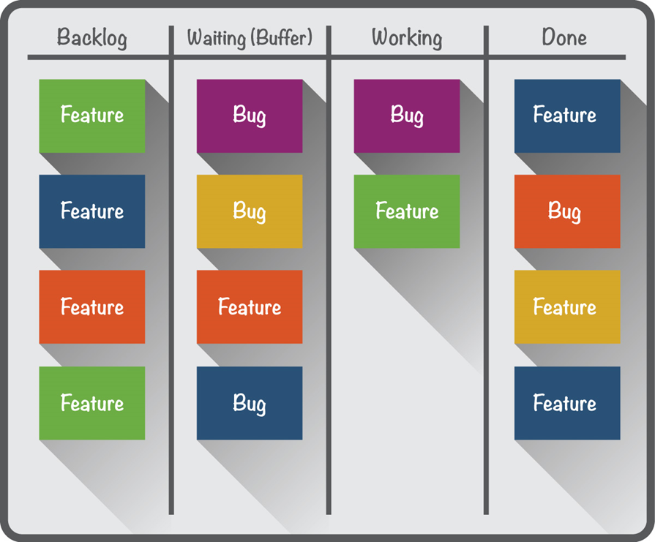
Operation of Kanban
Toyota has formulated six rules for the application of kanban:
Each process issues requests to its suppliers when it consumes its supplies.
Each process produces according to the quantity and sequence of incoming requests.
No items are made or transported without a request.
The request associated with an item is always attached to it.
Processes must not send out defective items, to ensure that finished products will be defect-free.
Limiting the number of pending requests makes the process more sensitive and reveals inefficiencies.
Operation of Kanban

Slide 16
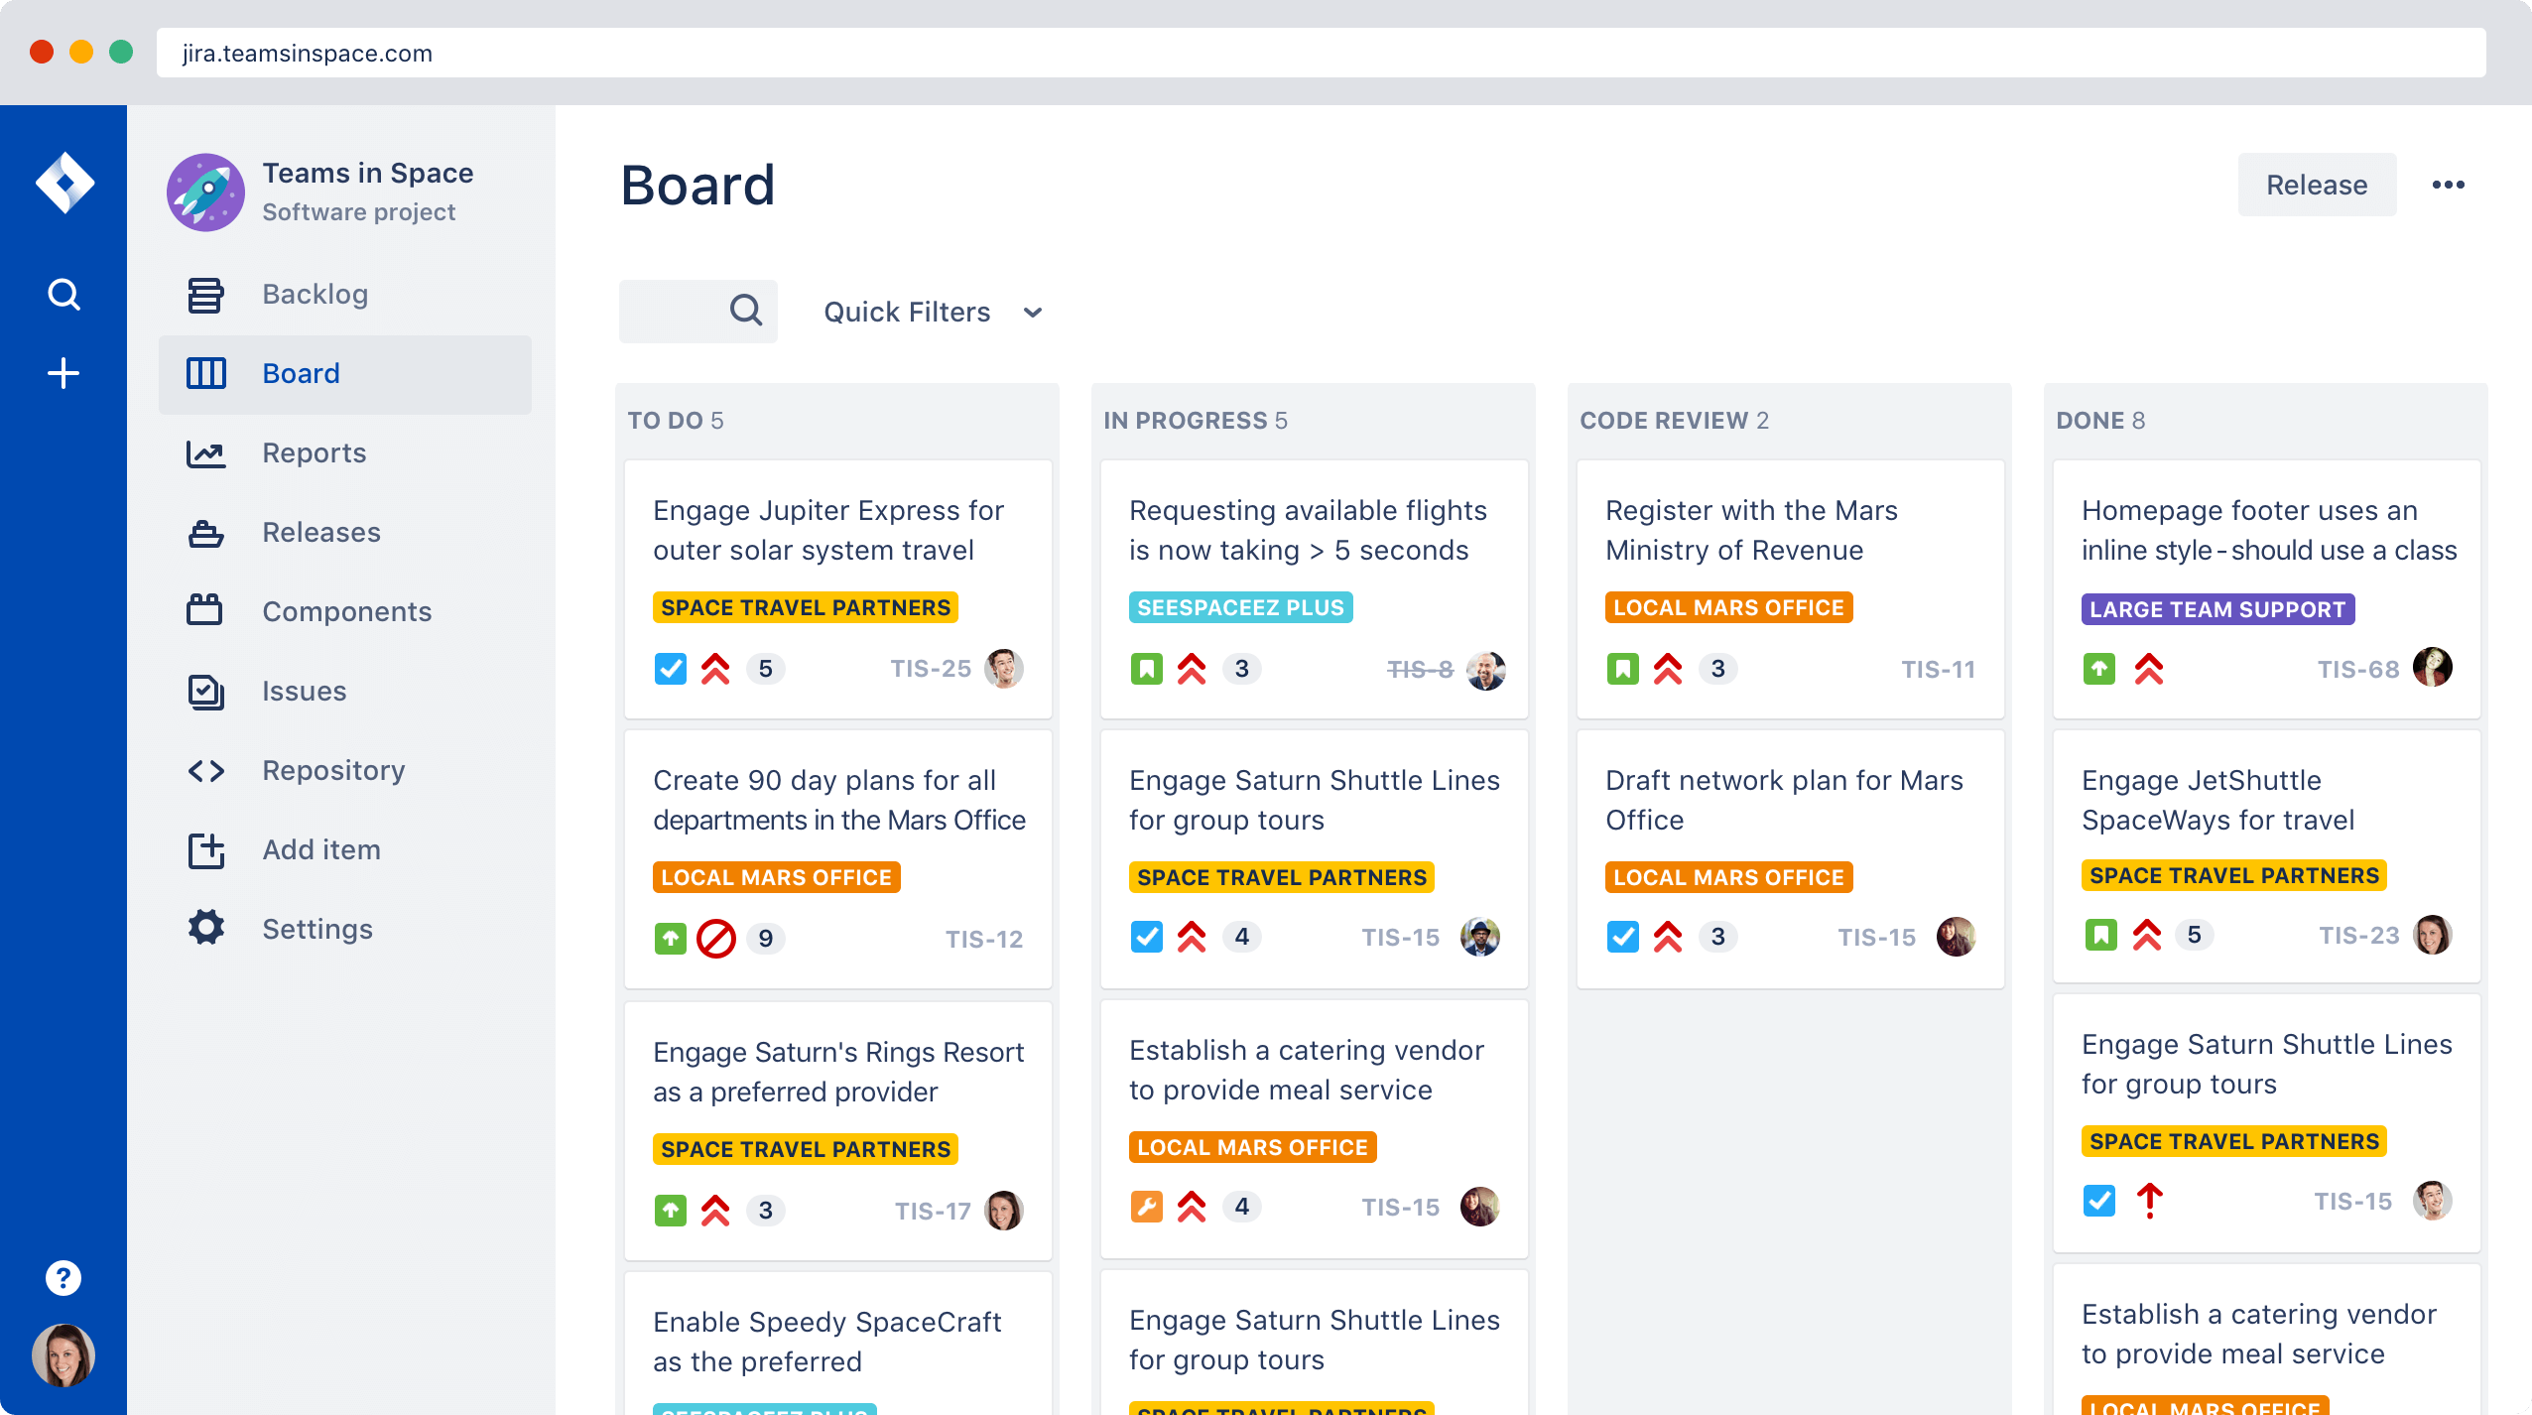
Jira
Jira is a proprietary issue tracking product developed by Atlassian that allows bug tracking and agile project management.
The product name is a truncation of Gojira, the Japanese word for Godzilla.
Jira Interface in Mac

Slide 17
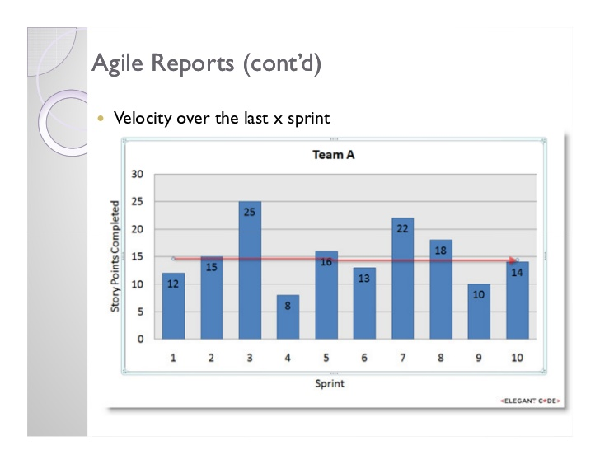
Velocity
Velocity is a metric for work done, which is often used in agile software development. Measuring velocity is sometimes called velocity tracking.
The velocity metric is used for planning sprints and measuring team performance.
There is no scientific evidence that measuring velocity improves planning effectiveness or team performance. Furthermore, the metric can be misleading.
Velocity chart

